Slide 1
Avionics Board
Danny

Slide 2
What it do?
Take environmental data (sensors)
Log data
Calculate when to move airbrakes
Move airbrakes

Slide 3
Sensors?
IMU (gyro + accelerometer)
Barometer (pressure sensor)
Temperature
GPS (location + super accurate time)
Airbrake Position

Slide 4
What else?
900MHz Radio for transmitting location
Micro SD Card for datalogging
Position monitoring of airbrakes
Control of airbrakes using PWM (Pulse width modulation)
Battery charging circuit (charges over USB)

Slide 5
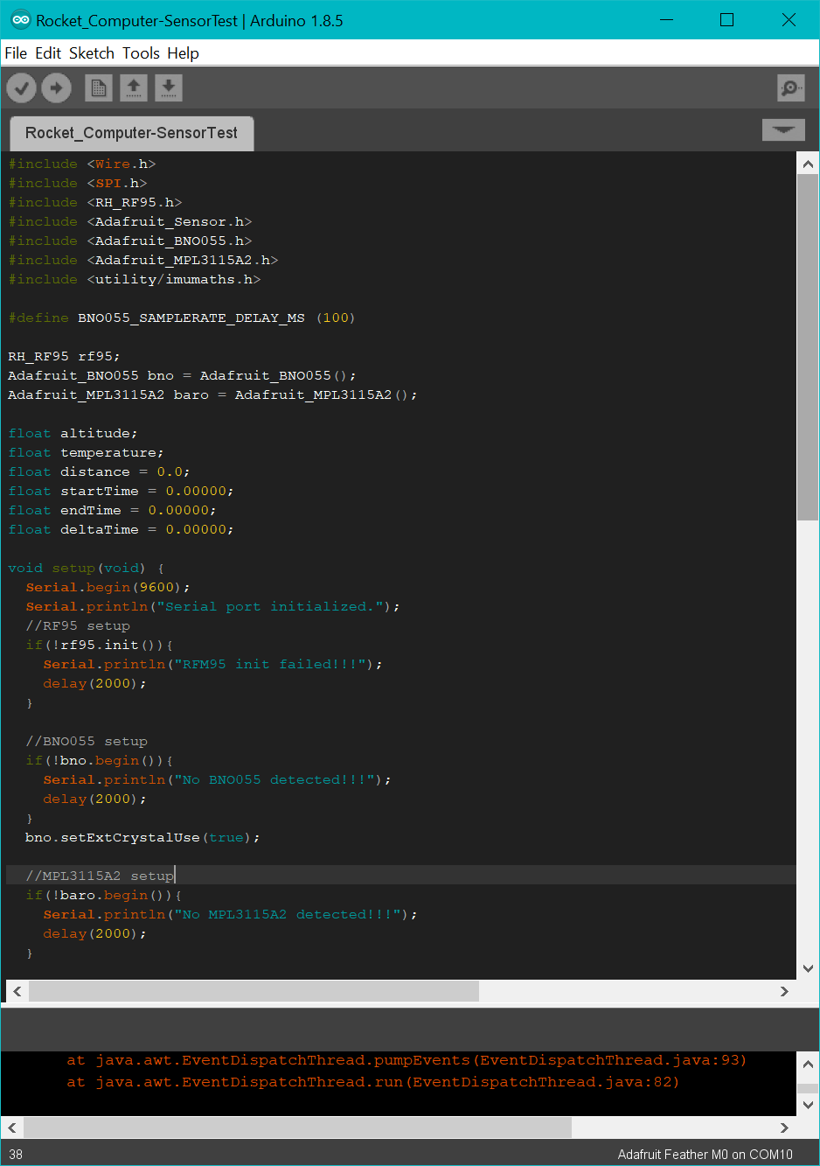
How to program?
Through Arduino IDE! Super Easy!
Go here: https://learn.adafruit.com/adafruit-feather-m0-basic-proto/setup and follow the instructions for “Arduino IDE Setup”, “Using with Arduino IDE”, and “Adapting Sketches to M0”

Slide 6
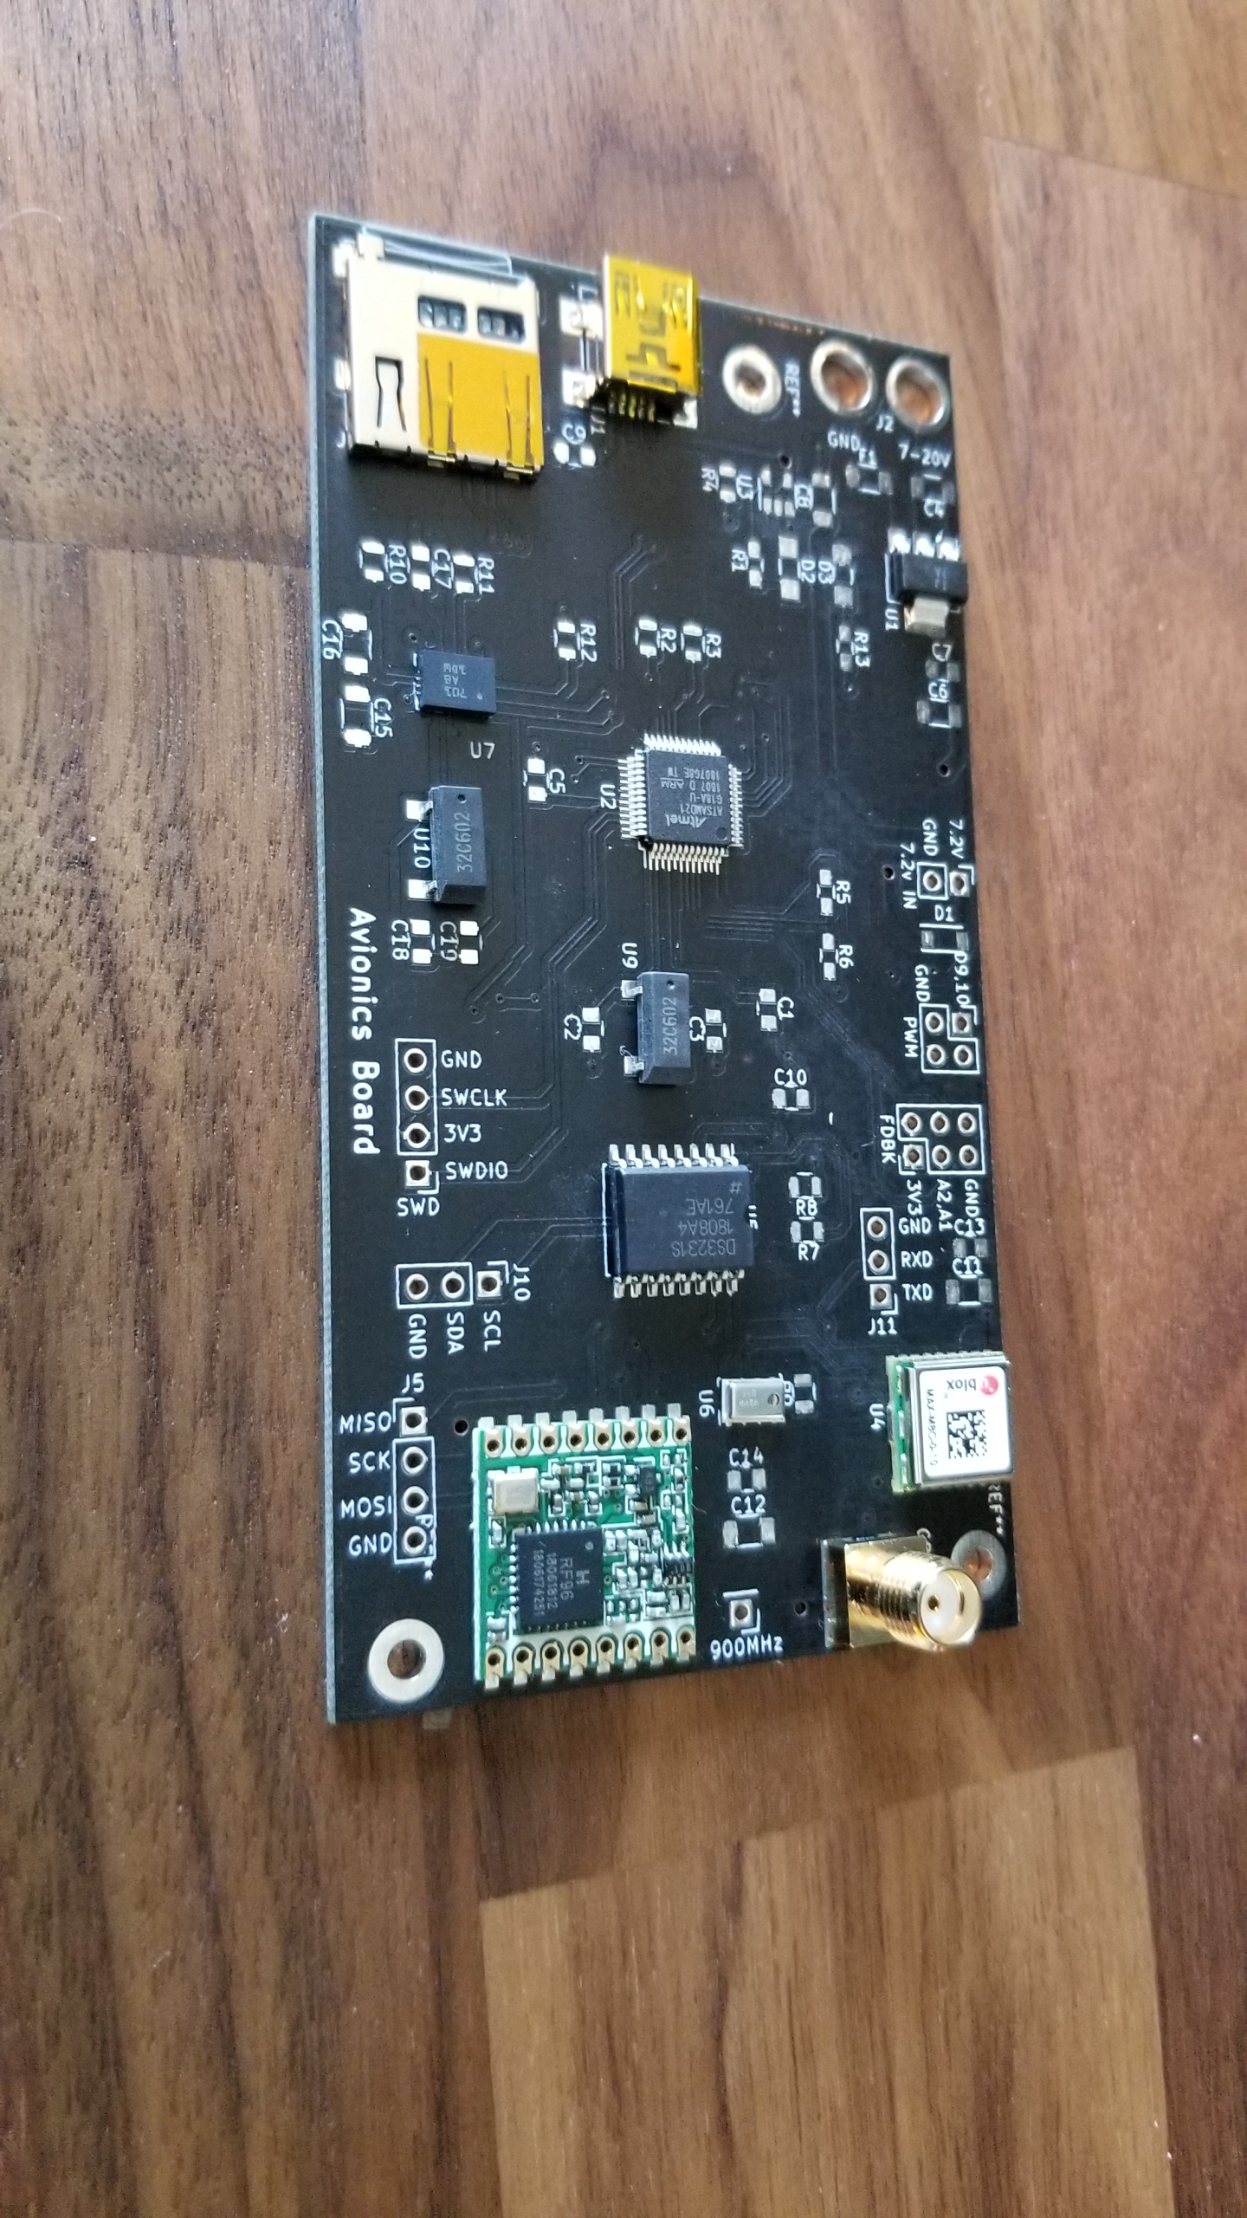
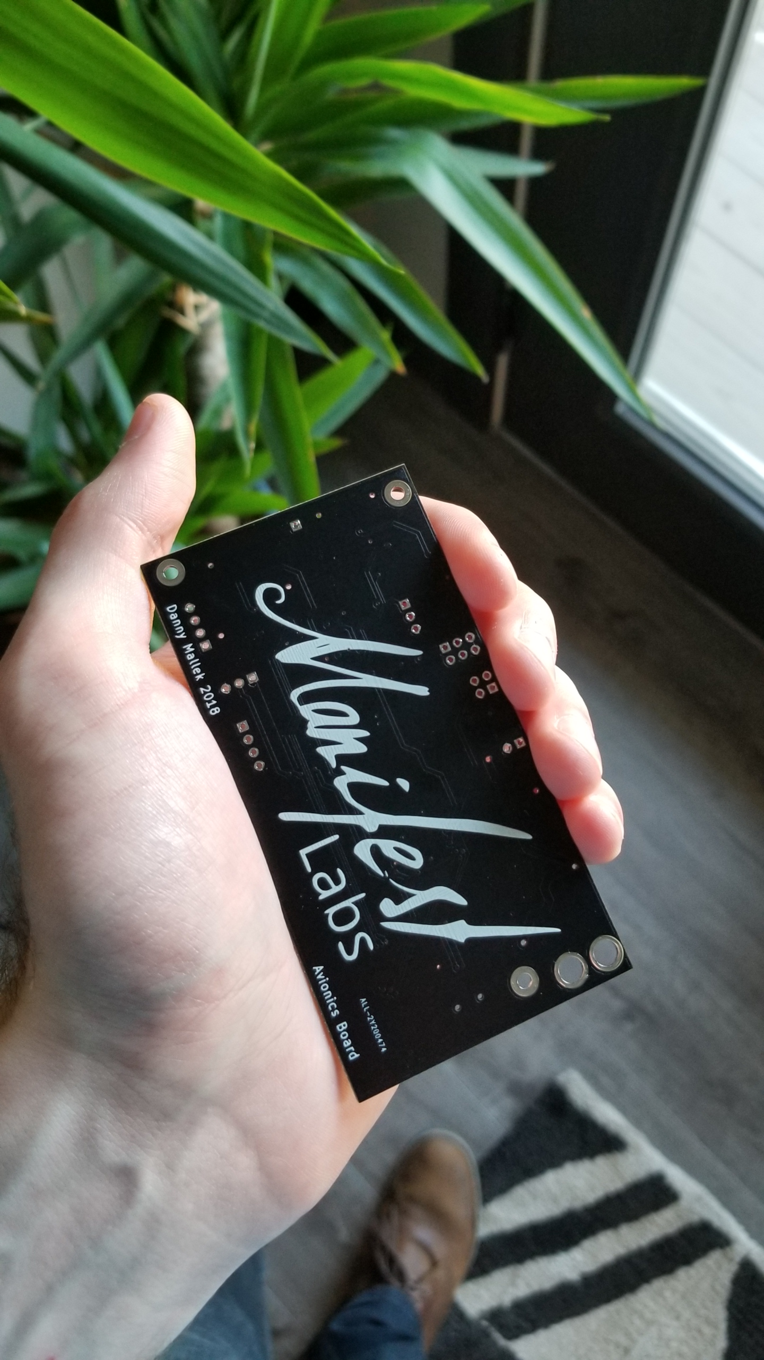
Pictures
Manifest logo will change to Rocket Shop

Slide 7
Looking forward
Avionics Board
Add status LEDs
Better power systems
Smaller board
Better connectors
More sensors? A second accelerometer for higher G’s?

